Slide 1
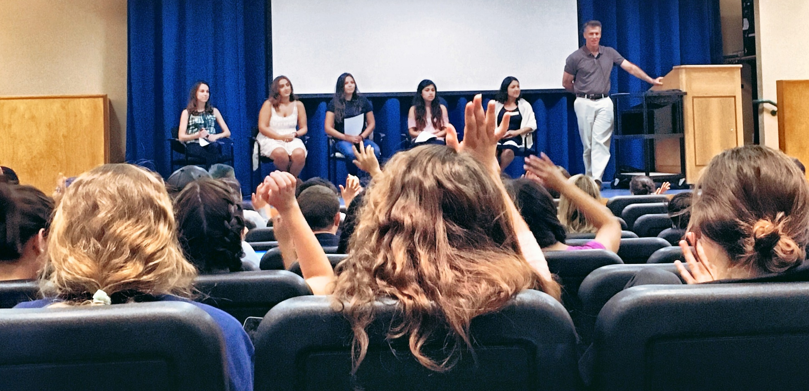
Pizza and Knowledge:
Re-Branding a College Advising Office
We Gaucho Back!

Slide 2
Origin Story
UC Conference 2013:
UCD student panel – “College advising is last resort”
Learning how campus works is overwhelming—repetition of information is useful
UCB presentation – Students operating on myths
Wake of IV tragedy—still not seeking advising

Slide 3
Program Goals
Combat myths that trip up students
Reduce intimidation of seeking academic advising
Give new students chance to ask questions in a comfortable environment

Slide 4
Format of Events
Panelists:
Importance of student experiences
Role of advisors/associates
Special programs
Questions to students, then to panel
Example
Panel preparation

Slide 5
Growth
First program: “Surviving Your First Year”
Reasons for seeing an academic advisor
Performed in Res Halls – FSSP and Fall quarter
Partnered with Athletics
Partnered with Intro to University Courses
Added: “Majors and Careers”

Slide 6
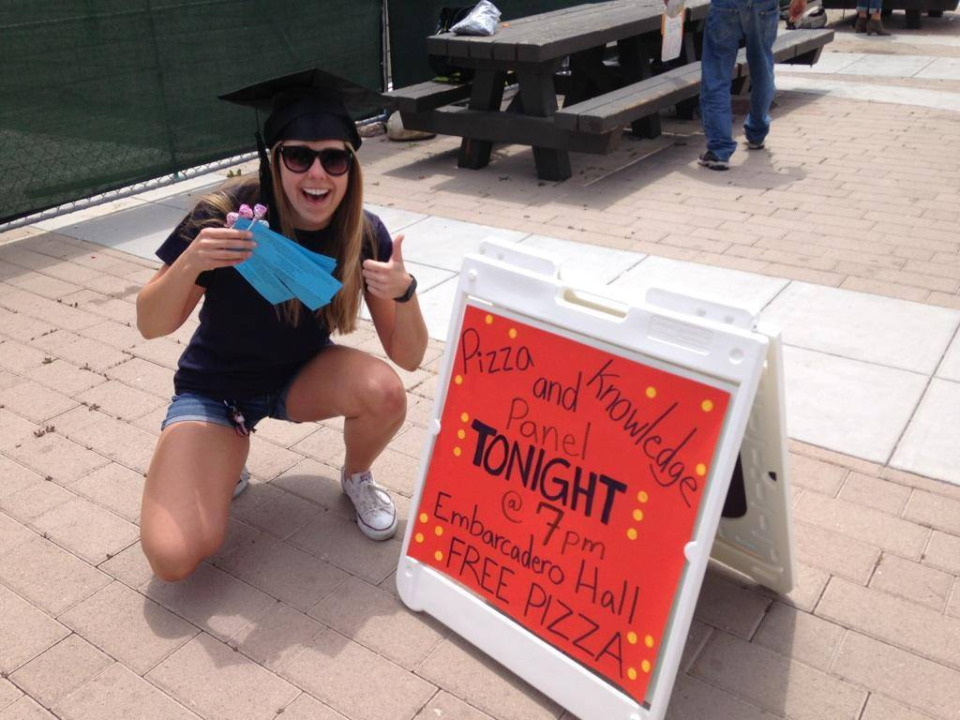
Growth: Advertising
Successful Strategies
Timing: Tuesday/Wednesday
Credit for class
Email Listservs
Branding: Visual
Bribery: Pizza
Multiple advertising hits
Word of mouth
Less Predictable
Credit for RAs
Posters in res halls
Visits to RA meeting
Tabling

Slide 7
Growth: Advertising

Slide 8
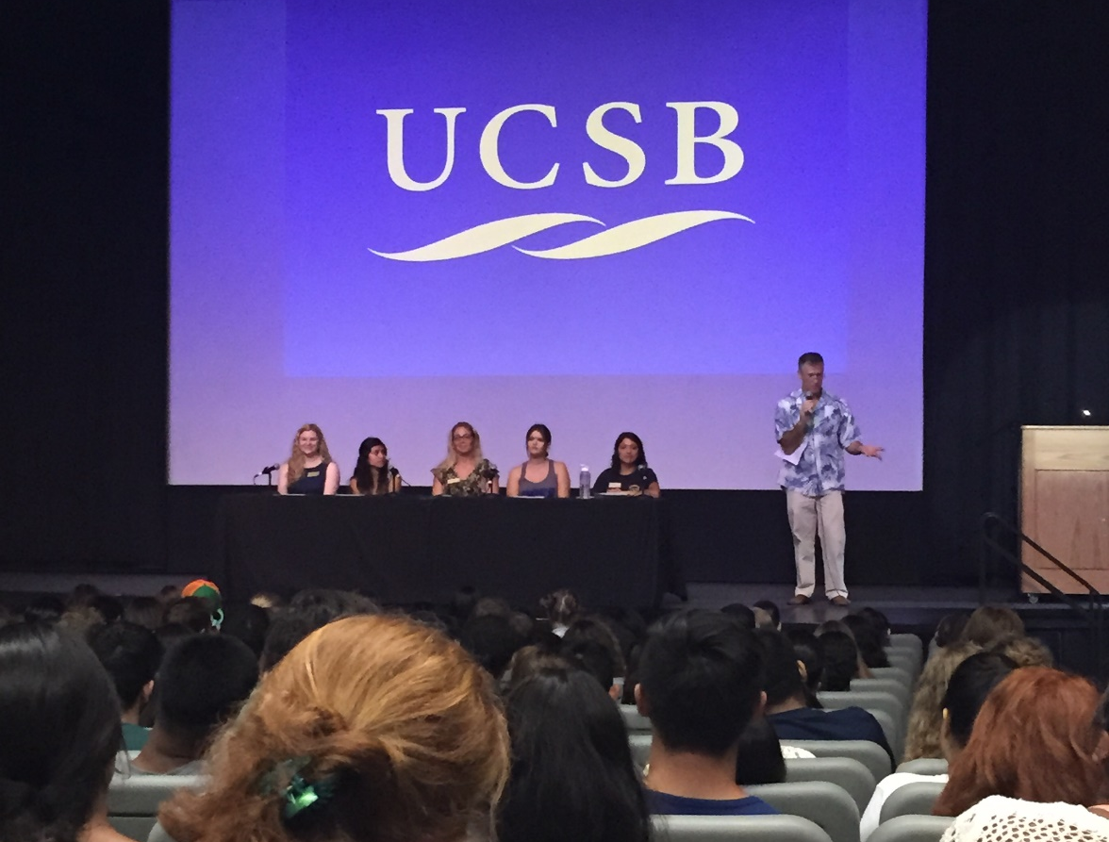
Current Programs
ORIENTATION: Surviving Your First Year
Sample Questions:
You get sick right before a midterm. What do you do?
You’re getting A’s in GE courses and not doing well in major courses. What does this mean?
If a friend was feeling like they don’t belong, why would you tell them to see an L&S advisor?

Slide 9
Current Programs
FALL: Academic Decision-Making
Sample Questions
What’s most important to focus on in 1st year: GEs, major courses, or electives?
Your first midterm grade was much lower than you were expecting. Should you change the course to Pass/No Pass?
You get a D- in a course. What are the pros and cons of repeating it?

Slide 10
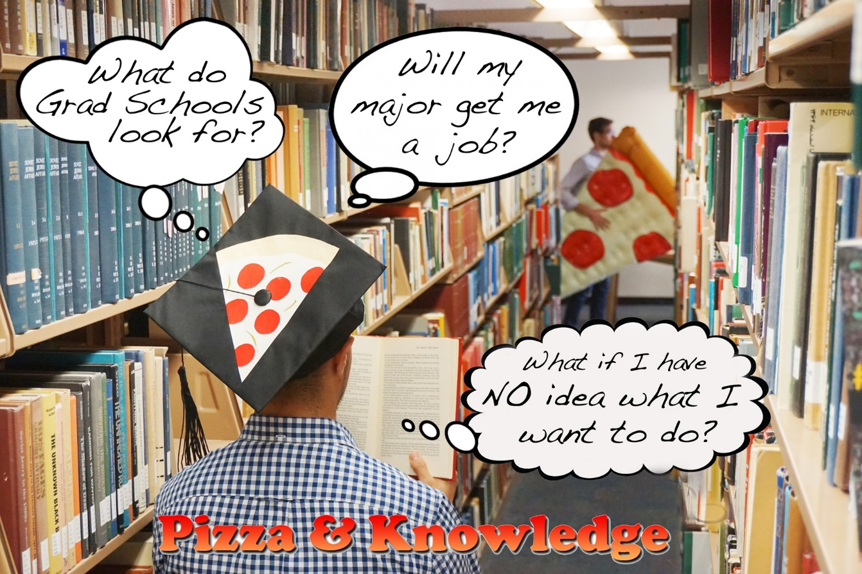
Current Programs
WINTER: Majors and Careers
Sample Questions:
Does a double major or major/minor make you more competitive than a single major?
What do you do when you’re interested in something that doesn’t match the expectations your parents have for you?
What would you do if the job market you want to go into becomes impacted or you ended up not liking your career?

Slide 11
Current Programs
SPRING: Special Event (Alumni Panel)
Sample Questions (To Alumni Only)
What did you think you were going to do as a career when you started UCSB compared to what you do now?
What was the biggest surprise about life after graduating?
Was major an important factor in getting your career? If not major, then what?

Slide 12
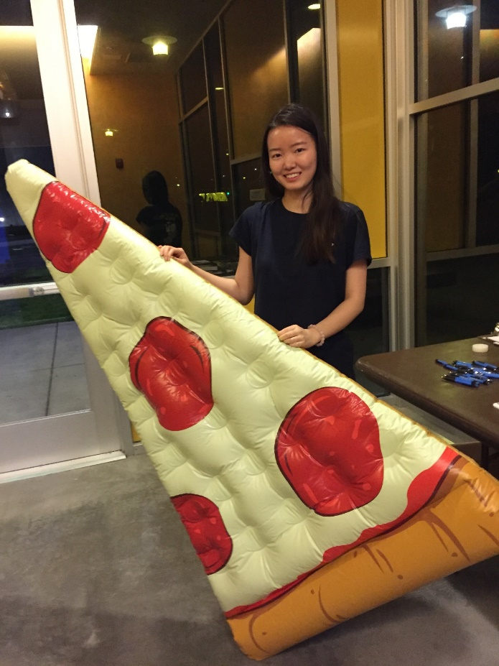
Student Impact
What was the most useful thing we covered today?
“It’s not over if you fail.”
Seeing information within larger context
Learning what questions to ask
Increasing awareness of preparation needed for experiences
Talking to other students and offices about busted myths (especially related to major)
Coming in for advising

Slide 13
Student Impact
Evaluation Responses
Q: How likely are you to seek academic advising this year? Why?
“Definitely! Hearing the implications of P/NP, purposefully failing classes, etc. […] There is a lot of misinformation in general on campus.”
“Yes! I feel like L&S has my best interest in mind and I have a hard time seeing the big picture on my own.”
“Yes. I was failing Bio but didn’t seek advising because I was lazy/embarrassed/didn’t want to accept the issue. But I just sent an email to the advising office during this session.”
“I thought advisors would judge me and tell me what I should do or should have done. I haven’t experienced that, but I had the thought. Now…very likely. It’s where I can get the help I need.”
“Very. I’m screwed and I need it!”

Slide 14
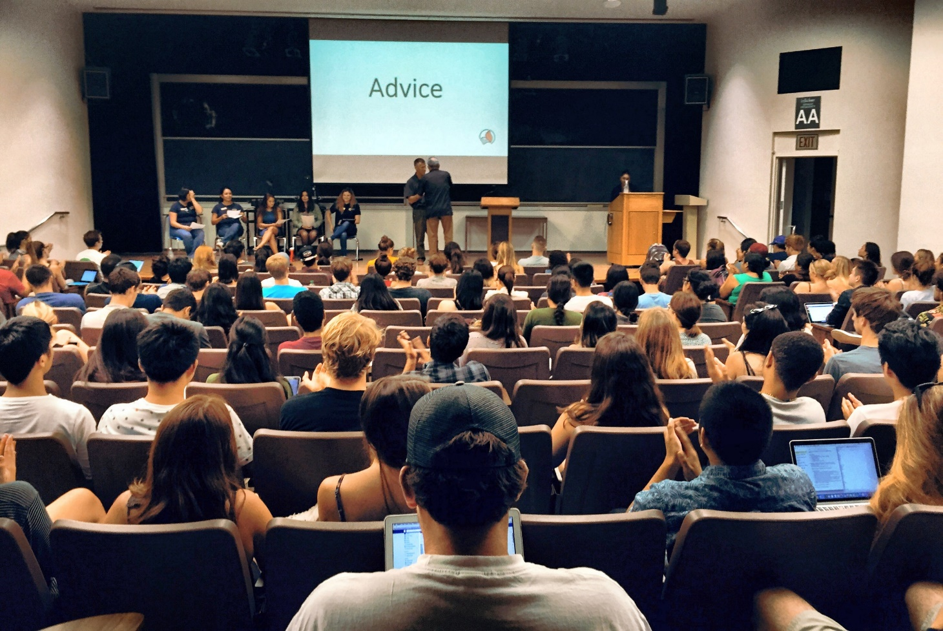
Office Impact
Looser criteria for Walk-Ins
Growing consciousness of student needs and concerns
Increasing functioning as a team
Unique experiences of different peers and staff
Aligning under higher goals
Reflection on how serving students and image we are promoting
Other offices looking for ways to collaborate:
EOP, Career Services, CAPS

Slide 15
Future of Pizza and Knowledge
Partnerships with
Orientation (Continuing)
Athletics (Continuing)
EOP
Career Services
Counseling and Psychological Services
Intro to the University courses (growing)
Videos
Marketing:
Social Media
Tabling and Classroom Announcements
#pizzaandknowledge
#alumnipanel

Slide 16
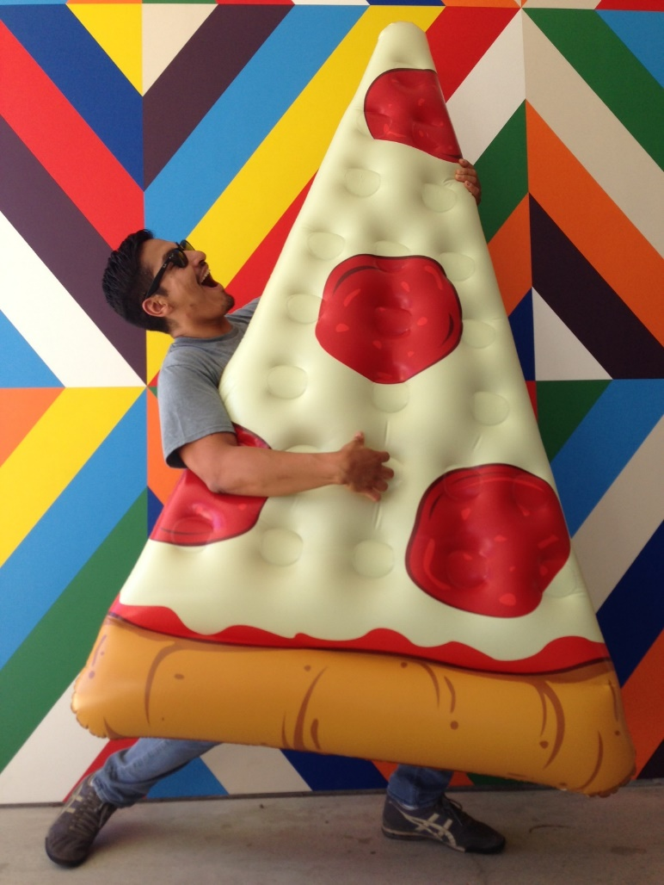
Thank You!
Questions?

Slide 17
Please evaluate!
Guidebook App: “Forms” (at bottom of event page)

