Slide 1
Professional Refresh: You and Your Career
Presented by the University of California, Davis
Arts Group Advising Center Team
Ariel Collatz, M.S., Undergraduate Programs Manager
Julie McGilvray, M.S., Undergraduate Adviser
Kathryn Shickman, M.A., Undergraduate Adviser and Program Coordinator
Notes:
Welcome and Introductions – Ariel will start, JM and KS will introduce selves. If there is a room monitor they can introduce the title and we can still introduce ourselves.
This came to fruition because of a question that a coworker asked me - which is what was your worst job - why this one! and what was your best job Same- this one or part of it anyway? This made me think what as the difference between the best and worst job you've ever had isn’t which office you are working in but all of the other factors that matter to your professional life.
Many of us have the same daily routines in our work environment. This repetition may make us feel less than enthusiastic about our job. The demand on our time for advising is increasing, while other tasks keep getting added to our workload.
Though we are dedicated to our students and our work, we may take little time for ourselves. Although we love our jobs, how do we stay fresh and continue to grow professionally?
To progress in your career does not necessarily mean you need to change jobs. It can simply mean enhancing your current position to grow both personally and professionally.

Slide 2
Objectives
1. Understand the life and career planning process
2. Identify values related to professional development
3. Clarify professional motivations
4. Gain new ideas to refresh your career
5. Create action steps for change
Notes:
The objectives of this workshop are to understand the life and career planning process, identify values and motivations, to develop ideas to refresh your career and create action steps. This workshop includes group learning activities and time for personal reflection.
We have some sharing activities and we ask that you share what you learned here, not any information that you learned about another participant.
Start with breathing/stretching activity (15 seconds). Can you hear your own voice?

Slide 3
1. Life and Career Planning Process
Notes:
Learning outcome: understand how personal values relate to professional development (using values to ask yourself the right questions); understand developmental career management.
The life and career planning process in one of continued growth. We’ll talk about a model for career planning, talk about a few analogies for thinking about our careers so we can find something that will work for us to think about the process.

Slide 4
Traditional Career Planning Model
Assess
Research
Decide
Execute
Notes:
Traditional life/career planning process
Self-assessments-mbti, strong interest inventory, true colors goal to gain self-knowledge.
Research options -informational interviews, use networks, job shadowing
The deciding time - choose a career
Implement an effective job search - update resume and cover letter, practice interview skills, get an offer, negotiate salary
This approach is necessary, but might not be sufficient. (as it doesn't say what to do next when you have discovered yourself, learned about you options, decided, found the perfect job and realized the joys of negotiating a reasonable salary (except for starting the process over again.)
In order to manage your career 'from the inside', a grand process may not make sense. Small and consistent steps are what will have a big impact in the long run. We'll talk about some steps later on to connect back to that.
Let’s talk about a few career analogies to shift our thinking. Our culture gives us the analogy of the career ladder

Slide 5
Career Ladder
Notes:
move up get more money, responsibilities, prestige, a bigger office etc.... This picture is based in a particular set of values that are based on our cultures expectations. But are these your values? And Is this a realistic or helpful model for thinking about your career. you may want to move up, make a lateral move or step back to start in a new area.

Slide 6
Career Closet
Notes:
Your career closet might look like this or like this. Just like your closet your career has parts that are changeable. Adding or brushing up on new skills, expanding your network, taking on a new project where you work with different people. You can stop using skills that you no longer enjoy using. Just as with your wardrobe in you job you can add pieces or subtract (taking stuff out of your job is getting harder these days, but still possible) remix them in different ways. In addition to skills, you have people in your network, interests, values, beliefs, motivations, approaches.

Slide 7
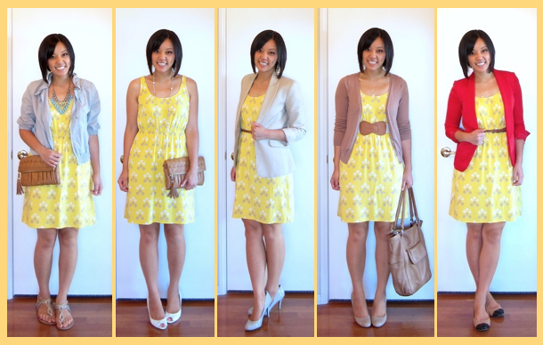
Notes:
Sometimes adding accessories can make a big impact on your wardrobe or switching things around can have an impact on how you feel about the same pieces. You make take on a few new responsibilities at your current job in preparation to make a change a few years down the road to a new position or to add more challenge and fun to your current position. By taking action now you may have more options later even if its not clear now what those options will be.

Slide 8
Notes:
What do we want from work?
What do you like about your present job?
What do you dislike about your present job?
Identifying current joys and struggles is one way to start thinking about what changes to make in your career. We are going to look at Identify values that relate to professional development, Clarify professional motivations, Gain new ideas to refresh their career, Create action steps.

Slide 9
2. Identify Values Related to Professional Development
“Values give us the stars by which we navigate ourselves through life”
~ Sidney Simon
Notes:
Julie –

Slide 10
Identifying Values
Have you ever quit a job, or ended a project you once felt eager to complete?
If true, what motivated you to change?
Notes:
It’s possible your personal values had an impact on your decisions, or a situation caused you to feel uncomfortable because of an incongruence with your values.

Slide 11
Values can be hard to identify
Unrecognized until publicly affirmed
Chosen after consideration of consequences
Values change over time
Unconsciously leading your life or consciously motivating you
Notes:
Values are developed over a period of time, beginning in our childhood.

Slide 12
Values in Life Roles
Notes:
We express our values through our life roles. For example these roles include:
Important Relationships
Career Choice / Our Work/ Community and leisure activities
We divide our time and energy in each role. It’s rare to find one life role satisfies all of our values.

Slide 13
Pursing work that is congruent with your values increases feeling of satisfaction and success.
Values are deeply held commitments
Values Assessment: 5 minutes to choose and list your top five values
Notes:
Most people who pursue work that is congruent with their values feel satisfied and successful in their jobs.
Announce: Please turn to Page 2 of the handout, and you will find a list of common values in the workplace.
Now, I am going to give you 5 minutes to review circle all the values most important to you, then list your top 5 on page 3

Slide 14
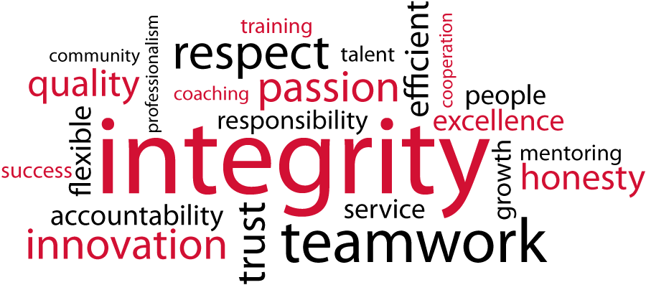
Values Assessment: questions 3 and 4 share with a partner
5 minutes to review and choose your top five values
Question 3 and 4 share with a partner
Values: deeply held commitments that influence your thinking when making choices
Notes:
Announce: now find a partner and share your answers to questions 3 and 4, you have two minutes for each question.
Keep in mind your values may be consciously or unconsciously motivating you in your work environment.

Slide 15
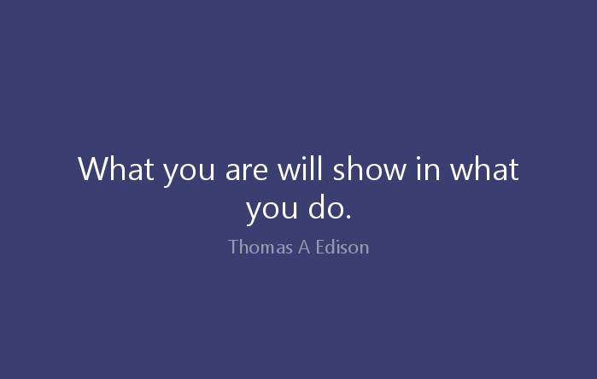
3. Clarify Professional Motivations
Notes:
Learning outcome: identify professional motivations What motivates you?
What gets you going? What fills your tank? What recharges you/your engine?
Julie talked about the importance of values in clarifying what is important personally and professionally. Values are those deeply held commitments that influence the decisions you make and there are other components of who we are the impact the work we do and the meaning that we make from that work. Values don’t tell you what to do. We are going to add another layer by taking about your motivations.
The idea of identifying who we are, what we value and what motivates us in life is a pretty weighty question. Before we get started, let's take some of the pressure off of the question "what motivates you?" You don't carry the same goals, values, priorities throughout your whole life so you're motivations are likely to change too.
A friend of me called one day with a confession - she had purchased “sensible” shoes and she planned to wear them. I reassured her that it was ok since we were allowed to change and if we did not we would still be trying to figure how to kick our legs

Slide 16
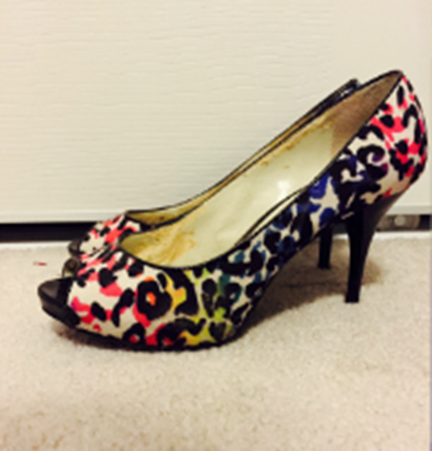
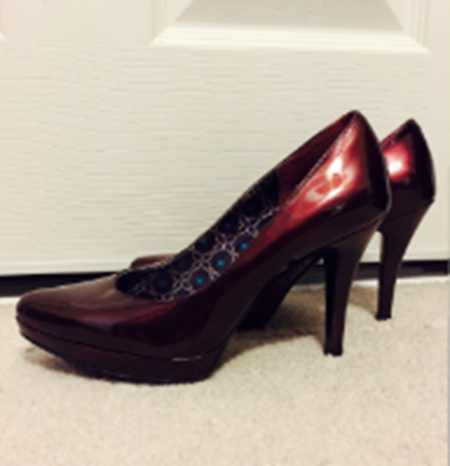
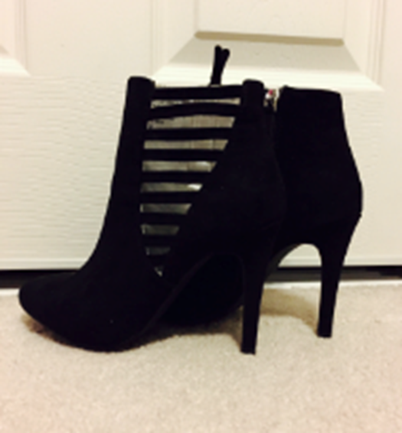
Notes:
Just to give you an idea of how hard it was for her to purchase sensible shoes here are three pairs of shoes I found in her house last week.
Since we can expect to grow and change throughout our lives we can choose to focus on where we are today and revise it tomorrow if needed. Us perfectionists in the room are advised to take a deep breath right now.

Slide 17
Reflective Writing Activity
Notes:
Activity Clarifying Professional Motivations - I am going to ask you the questions and give you a few seconds to write down each answer. We are talking about work life so answer the questions about work.
What do you love to do? Hint: What makes you come alive? What are you doing when you lose track of time? When do you feel like yourself? See next page for action word list for more hints.
Who do you do it for? Hint: who outside yourself benefits from the work you love to do? (Not to pay bills for our families). If you are not doing it for that group who would you want to do it for?
What are their wants and needs? Hint: What would make their lives richer? What have they asked for
How are these people changed by your interaction with them? Hint: What changes do they notice in themselves? What changes do you notice?
What does this say about what you believe? Why do you do it? Hint: one answer is I believe in the value of the change
You might be still working on that last one for a while because getting to the ‘why’ is a little more central to who you are and further from the surface of what it is that we do. We don’t often work in the ‘why’ we are more often talking about what it is that we do or how it is that we do it.
Being able to identify your motivations with one sentence can provide a powerful way to communicate with yourself and others about what drives you. One sentence that can drive your decisions along with your values.
Let's do a pair share with your neighbor what you came up for each of the answers. Then ask each other clarifying questions to dig a little deeper about the meaning behind the answers. You may want to play the role of a 3 year old even and ask why a few times.
Come back together as a group.
Would anyone like to share what they have come up?
What was your experience talking about your beliefs?
What did you learn about yourself?
What did you notice about the connections with your values?
Anyone share their why sentence?
I believe that growth, exploration and creativity are central functions of all human beings.
Thanks for your sharing

Slide 18
4. Gain New Ideas to Refresh Your Career
Notes:
Kathryn 10-15 minutes
We are now going to do a group brainstorming activity to gain new ideas to refresh your career
In order to do this activity everyone please gather in groups of 4-6 people in front of the large post-it notes along the walls of the room.
Some of you may prefer to stay in the chairs form small groups of with the person next to you and the people in front or behind you, using the large colored index cards we made available.
People go off to create groups

Slide 19
* Professional Development * Personal Growth/Work-Life Balance * Relationships/Communication * Physical Environment * Other
Brainstorming Activity
Notes:
Kathryn con’t.
Your task is to brainstorm as many ideas as you can to refresh your career.
It may be helpful to consider these themes when you are brainstorming. They are meant to inspire you but your ideas do not need to fit in to these themes.
1. Professional SKILLS and DEVELOPMENT – how do you want to grow professionally
2. Personal Growth and work-Life Balance – what areas in your life do you want to focus on more
3. Relationships and Communication – do you want to improve relationships with colleagues or communicate more effectively within your department
4. The physical space in which you work – how might you enhance your work environment
We have provided some suggestions to get you going on page 6 of the handout.
Please NOTE: I will be collecting the index cards so you may want to keep your own notes on a separate card or on the handout.
Now take 5 minutes or so to see what ideas you have.
Let’s see what ideas each group came up with.
I will compile a list of all these amazing ideas and will share them with those who are interested. If you would like a copy of the list email me and I will send it to you.
Now Julie is going to talk with you about how to take these ideas and create your own personal action plan.

Slide 20
Ideas to refresh your career:
If you would like to receive a list of ideas to refresh your career, email Kathryn Shickman at kjshickman@ucdavis.edu
Notes:
We came up with a few ideas to get you started. Interested to hear what ideas you have.
Ask people to share ideas with the group.

Slide 21
Ideas to refresh your career:
Sign up for a staff training course
Maintain a professional network via social media
Keep a Journal of your work accomplishment
Write a personal mission statement
Start an exercise, walking or meditation group on campus
Develop deeper relationships with people across campus
Rearrange your office space
Update your wardrobe
Apply for a new job
(adapted from Career Fitness Check, careerlab.com)

Slide 22
Group Brainstorming - Ideas to refresh your career:
Cross train with others in your department
Network with others advisers across UC campuses
Partner with student resource centers across campus
Seek support systems
Set up informational interviews to get ideas
Attend professional development training programs
Set boundaries between work and personal life
Make your workspace a reflection of yourself
Set up your workspace to facilitate connections with coworkers
Notes:
Page 1

Slide 23
Group Brainstorming - Ideas to refresh your career:
Join professional associations like NACADA
Read advising journal articles and discuss with others
Attend lecturers/conferences on campus
Reach out to colleagues to build a network (coffee, lunch)
Take breaks
Schedule in “me time” for self improvement activities
Establish goals for the future and discuss with family
Create more space to facilitate collaboration
Join a committee
Redecorate your work space
Notes:
Page 2

Slide 24
Group Brainstorming - Ideas to refresh your career:
Talk about your achievements, brag a little
Celebrate your accomplishments
Mentor someone or find a mentor
Create a wellness group to walk or workout together
Arrange a mindfulness workshop for the office
Schedule “walking” meetings outside
Update your resume
Join professional groups outside of campus like toastmasters
Volunteer
Plan time for self-reflection and assessment
Notes:
Page 3

Slide 25
Group Brainstorming - Ideas to refresh your career:
Add a candy dish or cookie jar to your desk to invite visitors
Schedule a longer lunch once in awhile
Offer to serve as interim for higher level positions
Work from home
Establish uninterrupted periods of work
Consider a flexible work schedule
Create a personal mission statement
Use a standing desk regularly
Find a lunch/break buddy to remind you to leave your desk
Notes:
Page 4

Slide 26
Group Brainstorming - Ideas to refresh your career:
Take a class in something you were always curious about
Take a mental health day
Schedule a day to clean and organize
Cultivate relationships with student employees
Try flextime
Rewrite your job description to better reflect what you do
Improve the lighting in your office space
Plan an informal group happy hour
Organinze a Pay Day team lunch
Clean out your inbox
Notes:
Page 5

Slide 27
Group Brainstorming - Ideas to refresh your career:
Schedule monthly advising team meetings
Create a break room or staff only space
Notes:
Page 6

Slide 28
5. Create Action Steps for Change
Action Plan for a ‘Professional Refresh’
1. Set an Outcome Goal - big picture
2. List related Values and Motivation
3. Develop Process goals - action steps
4. Set dates and follow up
Notes:
Have you ever attended a conference and learned new ideas or processes, but then once you get back into your work environment you don’t actually do it?
An OUTCOME goal is the ultimate goal you want to achieve. The big picture goal.
PROCESS goals are the habits or activities we do that lead us to the outcome goal.
Its possible you may not have an outcome goal in mind. If so develop process goals to achieve what is important to you and the outcome goals may come to you sometime in the future.

Slide 29
Example:
Outcome Goal - to be more organized
Values - simplicity, effectiveness, organization
Motivation - empowering students
Process Goals -
Learn new ways to organize my work day
Read Franklin Covey books
Ask colleagues to share best practices

Slide 30
Meeting Your ‘Professional Refresh’ Goals
Share a business card with someone and agree to check in a month from now.

Slide 31
Questions and Comments

Slide 32
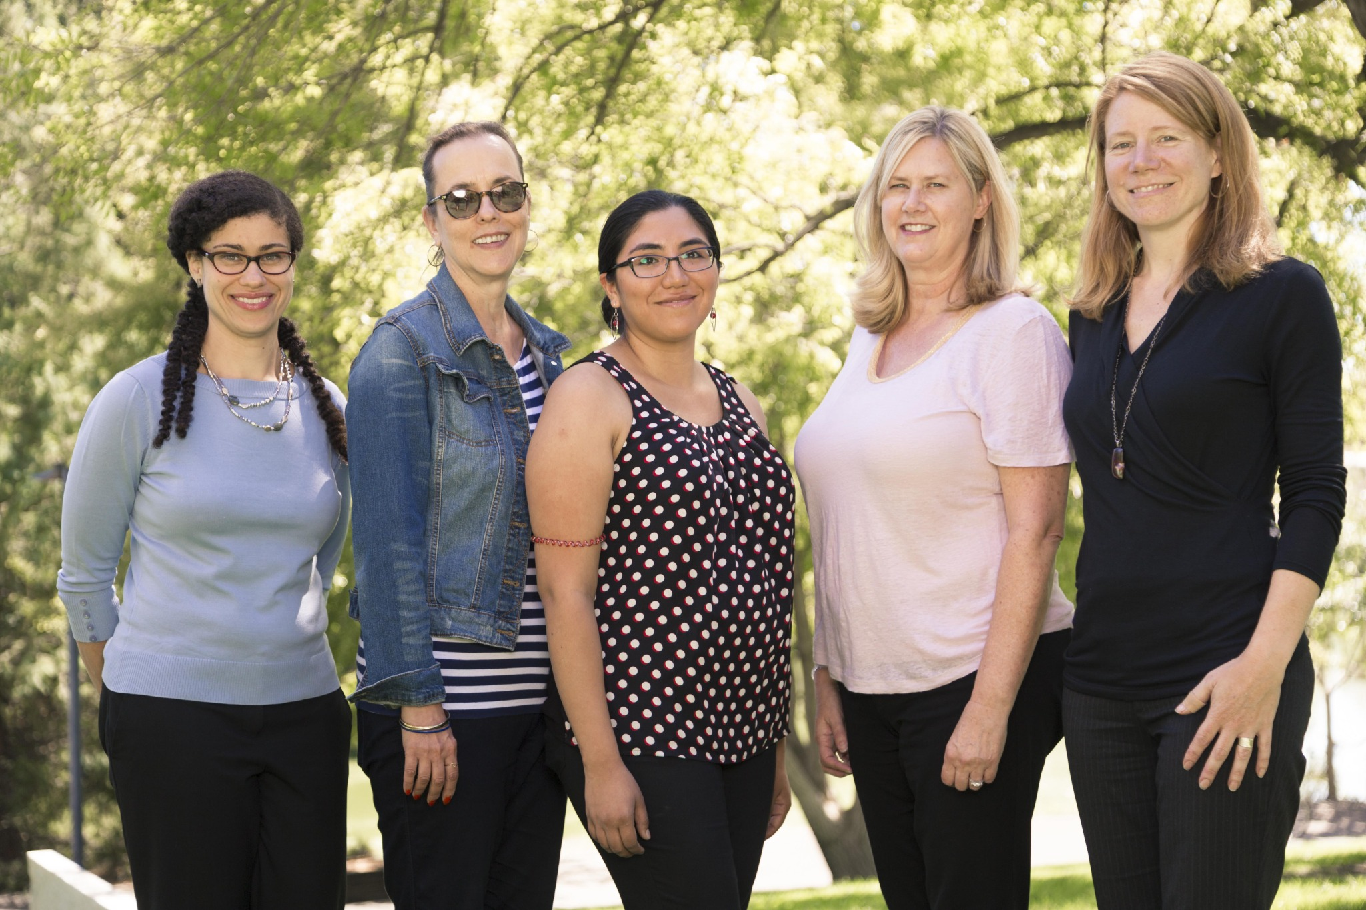
Thank you!
The University of California, Davis Arts Group Advising Center Team
Ariel Collatz, M.S., Undergraduate Programs Manager
Barbara Olivier, Undergraduate Adviser and Program Coordinator
Pamela Pretell, Undergraduate Adviser
Kathryn Shickman, M.A., Undergraduate Adviser and Program Coordinator
Julie McGilvray, M.S., Undergraduate Adviser
Notes:
Kathryn con’t
A reminder to please leave your index cards on the table so that I can compile all your wonderful ideas and share them with you.
We want to thank you for attending our presentation.
We hope you are leaving this session and this advising conference in beautiful Santa Barbara feeling professionally renewed and refreshed and with lots of inspiring ideas to bring back to your desk.
Thank you!

Slide 33
Bolles, R. (2013). What color is your parachute? 2014: A Practical Manual for Job-Hunters and Career-Changers. Berkeley, Calif.: Ten Speed Press. Dweck, Carol, (2006). Mindset: The New Psychology of Success. Ballentine Books,. Frank, W. (n.d.). CareerLab Quick Career Fitness Test. Retrieved from http://www.careerlab.com/art_quick.htm Howden, Hollee, (2012). How to Love Your Job - Career Success from the Inside Out, Kindle eBook. Howden, H. (2012, January 1).Your Place for a New Career and a Job You Love - Career Success from the Inside Out. Retrieved from http://www.careerrejuvenationspa.com Krumboltz, J., & Levin, A. (2010). Luck is no accident: Making the most of happenstance in your life and career (2nd ed.). Atascadero, Calif.: Impact. Leipzig, A. (Director) (2013, February 4). How to Know Your Life Purpose in 5 Minutes. Adam Leipzig at TEDxMalibu. Lecture conducted from TEDxMalibu. Nemko, M. (2014, June 6). 13 Analogies and Metaphors to Help Your Career. Retrieved from https://www.psychologytoday.com/blog/how-do-life/201407/13-analogies-and-metaphors-help-your-career Personal Goal Setting: Planning to Live Your Life Your Way. (n.d.). Retrieved from http://www.mindtools.com/page6.html Sloan, K., & Pollak, L. (2006). Smarter, Faster, Better: Strategies for Effective, Enduring, and Fulfilled Leadership. San Francisco: Jossey-Bass. Sinek, S. (Director) (2013, January 1). Start With Why. Simon Sinek. Lecture conducted from TED talk.
Sources and Resources

